Slide 1
LABEL SOFT COPY PRINT SOP

Slide 2
APPLICATION USED
LAB_IOFILE
PRINTSAMPLE (1.0.0.16)
STIMULSOFT DESIGNER

Slide 3
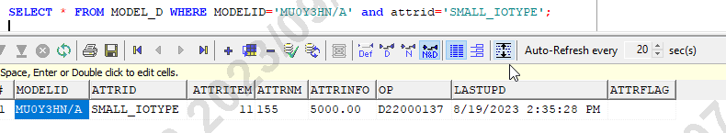
INPUT WILL BE RECIEVED FROM FPM (Price Detail)
FPM will share Price details to SFIS against MPN need to take.
Price need to be mainatined in MODEL_D (P1DB)
ATTRNM - IOTYPE Number to be maintained
ATTRINFO - MRP price

Slide 4
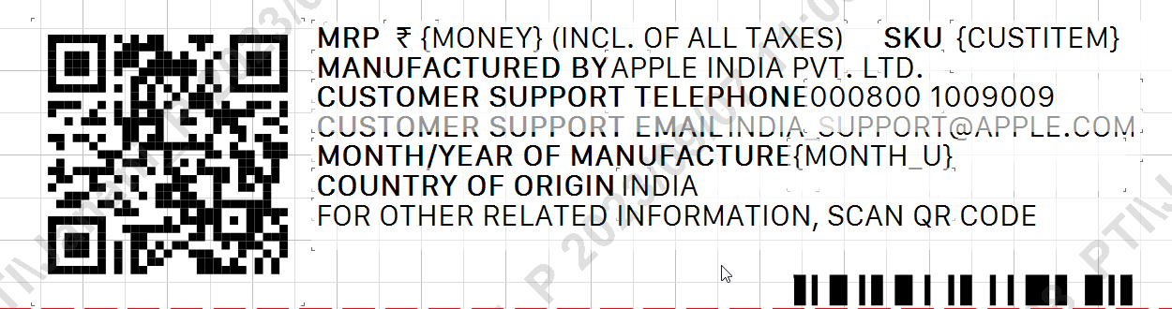
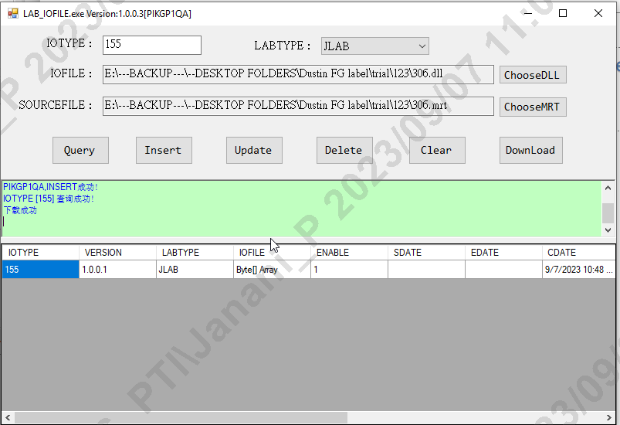
LABEL MAINTAINENCE
Label should be maintained with MPN,PRICE, YEAR, ISN,QRcode details and same should be saved in MRT and DLL format
Application Used : STIMULSOFT DESIGNER
Updated Label need to maintained against IOTYPE (DLL / MRT Format)
Application Used : LAB_IO FILE

Slide 5
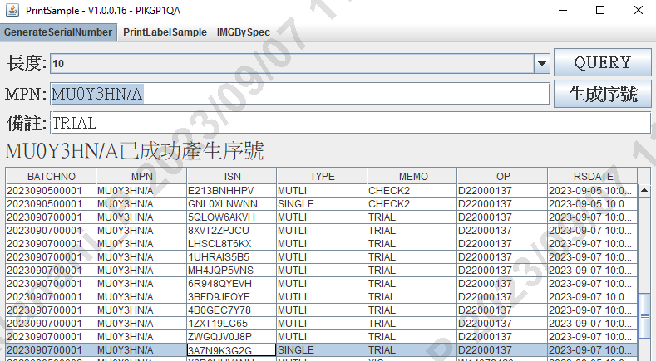
ISN GENERATED
Against Shared MPN ISN should be generated
Application Used : PRINTSAMPLE - Generate Serial Number

Slide 6
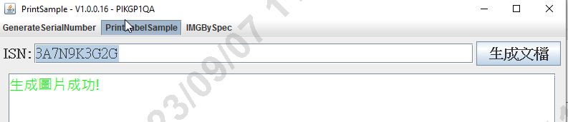
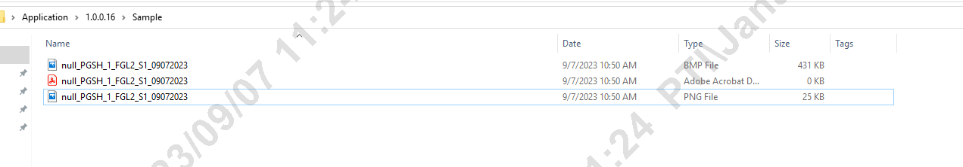
TO GENERATE PDF & JPG
With the help of generated ISN Soft copy can be generated
Application Used : PRINTSAMPLE - PrintLabel Sample

Slide 7
